Slide 1


BIT07 – Machine Learning
Cedric Hermans

Slide 2
Machine Learning
Naïve bayes

Slide 3
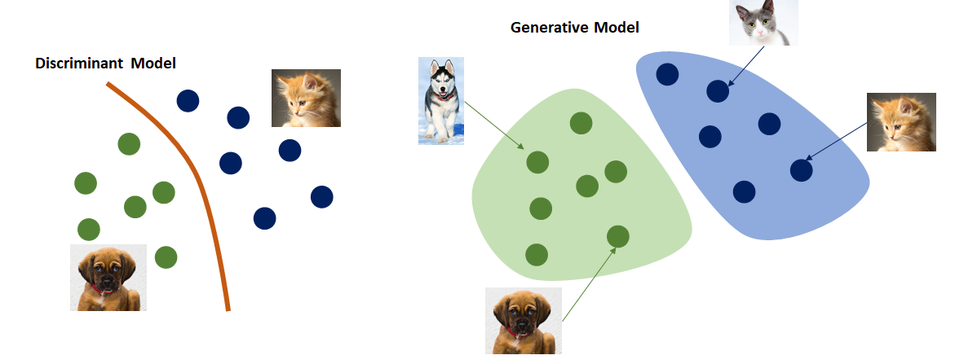
Discriminative vs generative classifiers

Slide 4
Discriminative vs generative classifiers
Until now: discriminant models
Learns the border between classes
No idea of the distributions of the classes
No idea of what it means to be of that class
Learns P(y|x):
What is the chance that our sample is of class ‘y’ given the features ‘x’
Also called the “posterior”

Slide 5
Discriminative vs generative classifiers
Generative models
Learns the distributions of the classes
=> Learns what it means to be of a specific class
Learns P(x|y) and P(y) (and uses it to determine P(y|x)):
P(x|y)
What is the chance that we have features ‘x’ if this would be class ‘y’
Also called the “likelihood”
P(y)
What is the chance of being of class ‘y’
Also called the “prior”

Slide 6
Discriminative vs generative classifiers
We can also define P(x)
What is the chance that we would have feature ‘x’
Also called the “marginal”

Slide 7
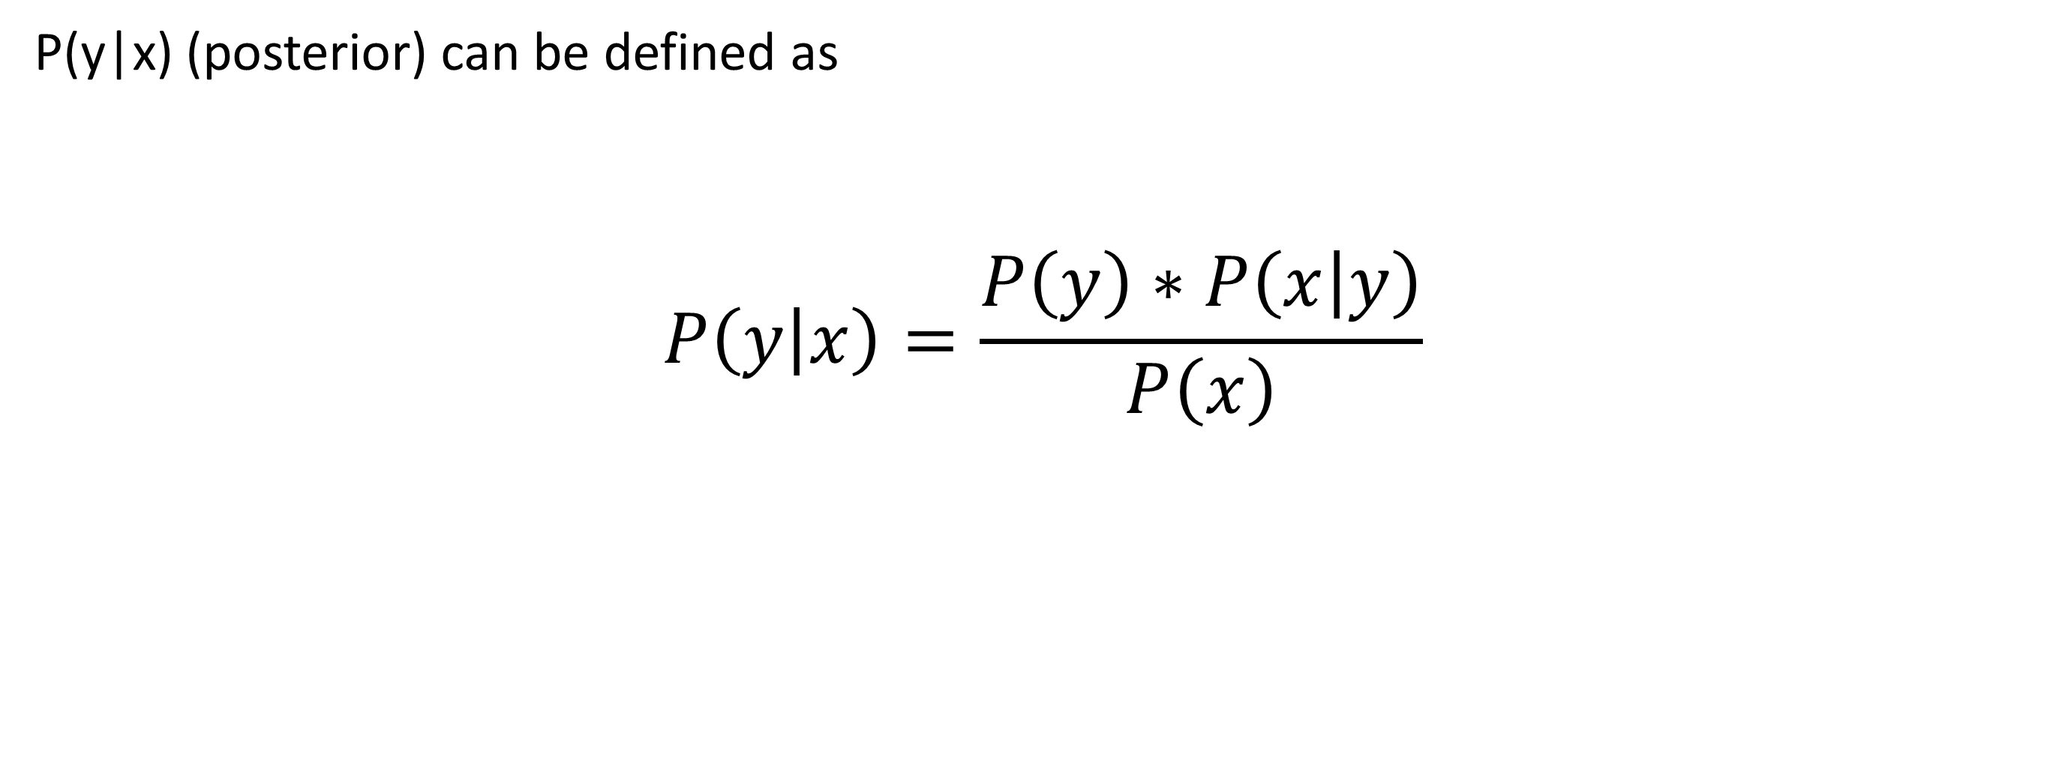
Discriminative vs generative classifiers
P(y|x) (posterior) can be defined as
$$P\left(y | x\right)=\frac{P\left(y\right)∗P\left(x | y\right)}{P\left(x\right)}$$
Prior
Likelihood
Posterior
Marginal

Slide 8
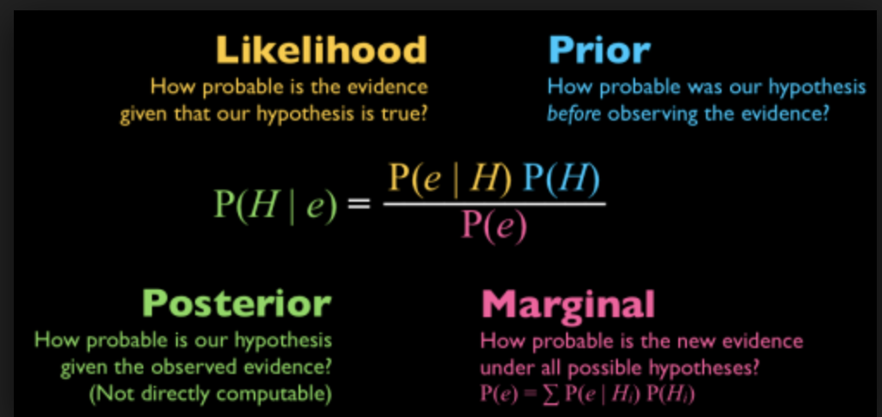
Discriminative vs generative classifiers
Overview

Slide 9
Discriminative vs generative classifiers
Examples of discriminative and generative classifiers
discriminative models:
Logistic regression
SVM
Decision trees
(basic) Neural Networks
Generative models:
Naive Bayes
Hidden markov model (comparative genomics)
Variational autoencoders (= special neural network)

Slide 10
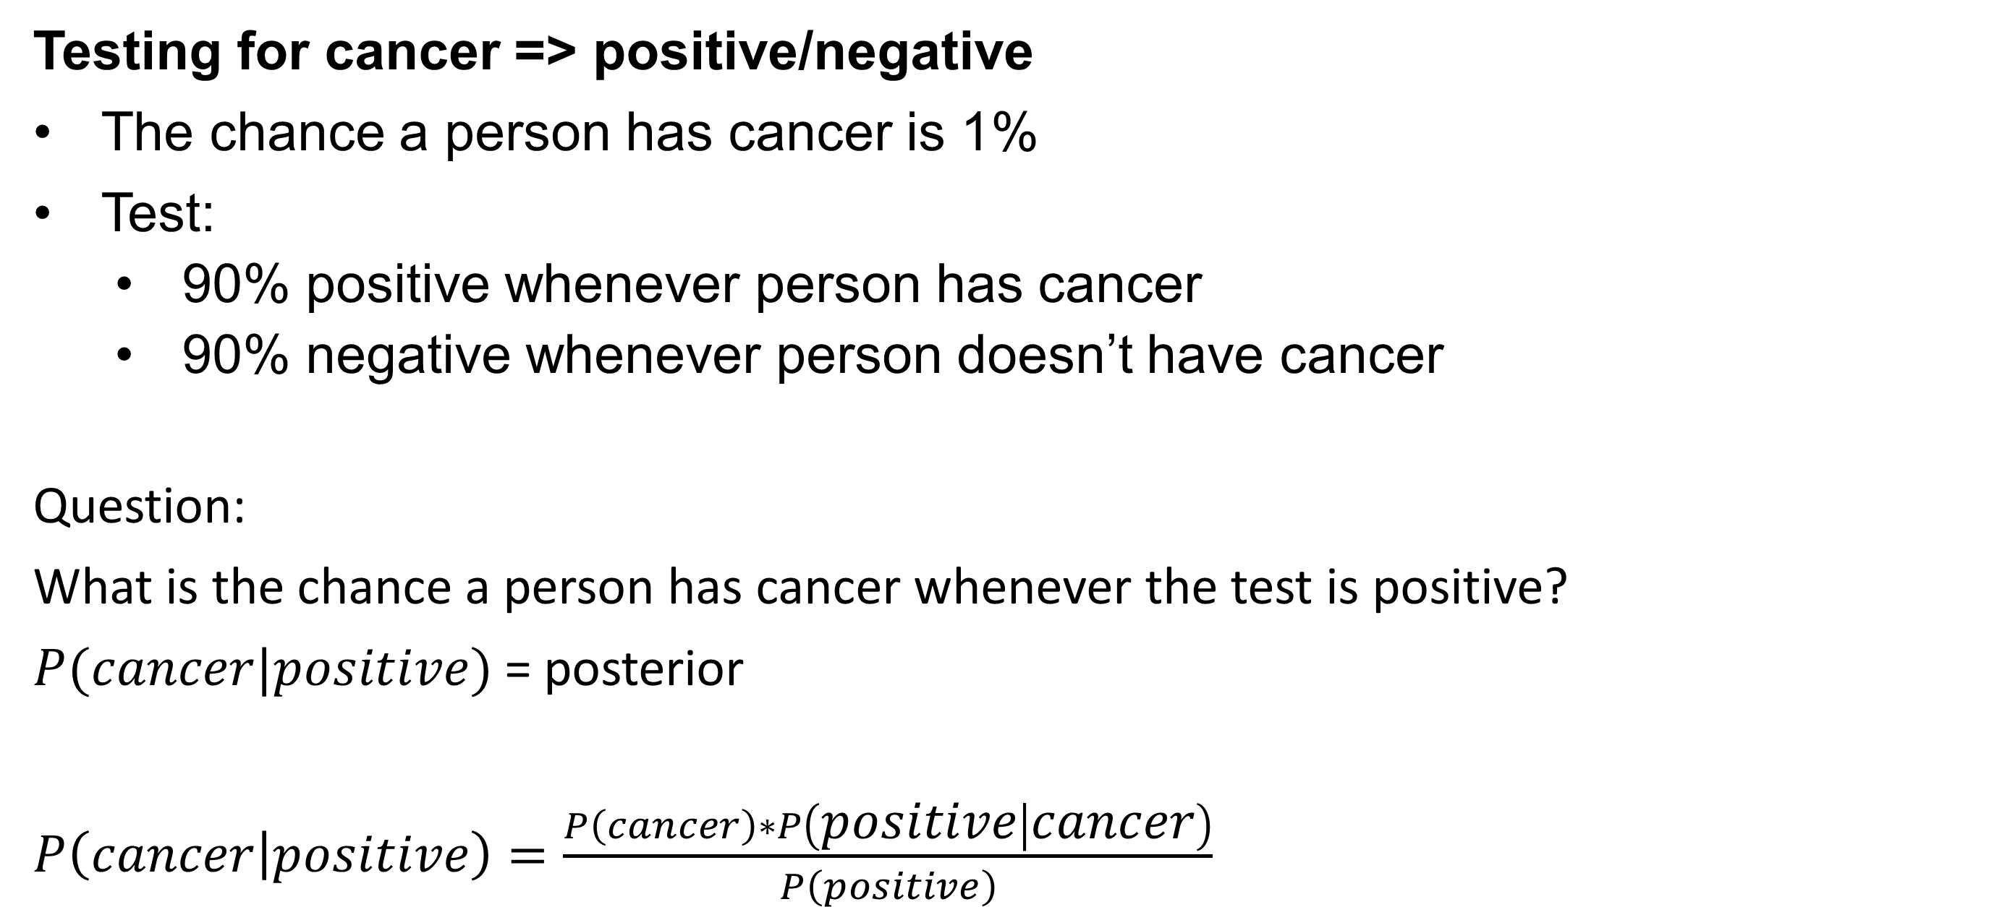
Example of likelihood calculation
Testing for cancer => positive/negative
The chance a person has cancer is 1%
Test:
90% positive whenever person has cancer
90% negative whenever person doesn’t have cancer
Question:
What is the chance a person has cancer whenever the test is positive?
$P(cancer|positive)$= posterior
$P\left(cancer | positive\right)=\frac{P\left(cancer\right)∗P\left(positive | cancer\right)}{P\left(positive\right)}$

Slide 11
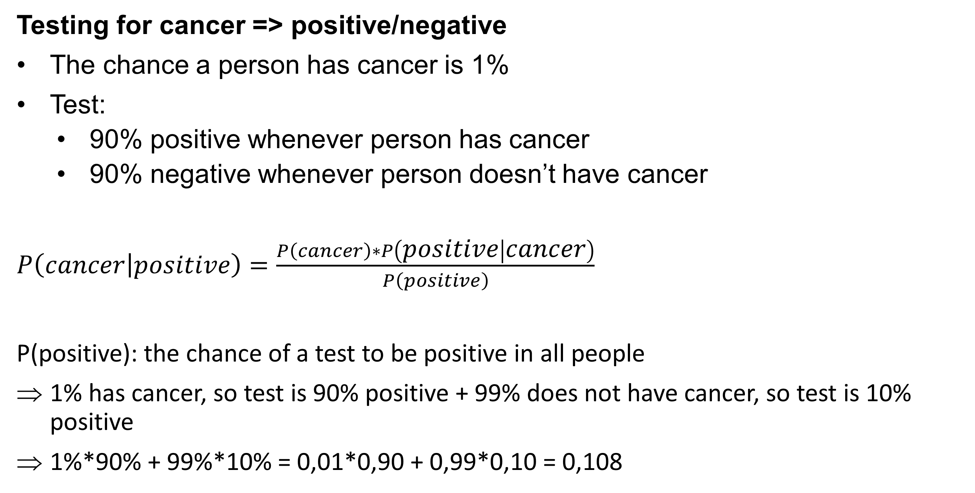
Example of likelihood calculation
Testing for cancer => positive/negative
The chance a person has cancer is 1%
Test:
90% positive whenever person has cancer
90% negative whenever person doesn’t have cancer
$P\left(cancer | positive\right)=\frac{P\left(cancer\right)∗P\left(positive | cancer\right)}{P\left(positive\right)}$
P(positive): the chance of a test to be positive in all people
1% has cancer, so test is 90% positive + 99% does not have cancer, so test is 10% positive
1%*90% + 99%*10% = 0,01*0,90 + 0,99*0,10 = 0,108

Slide 12
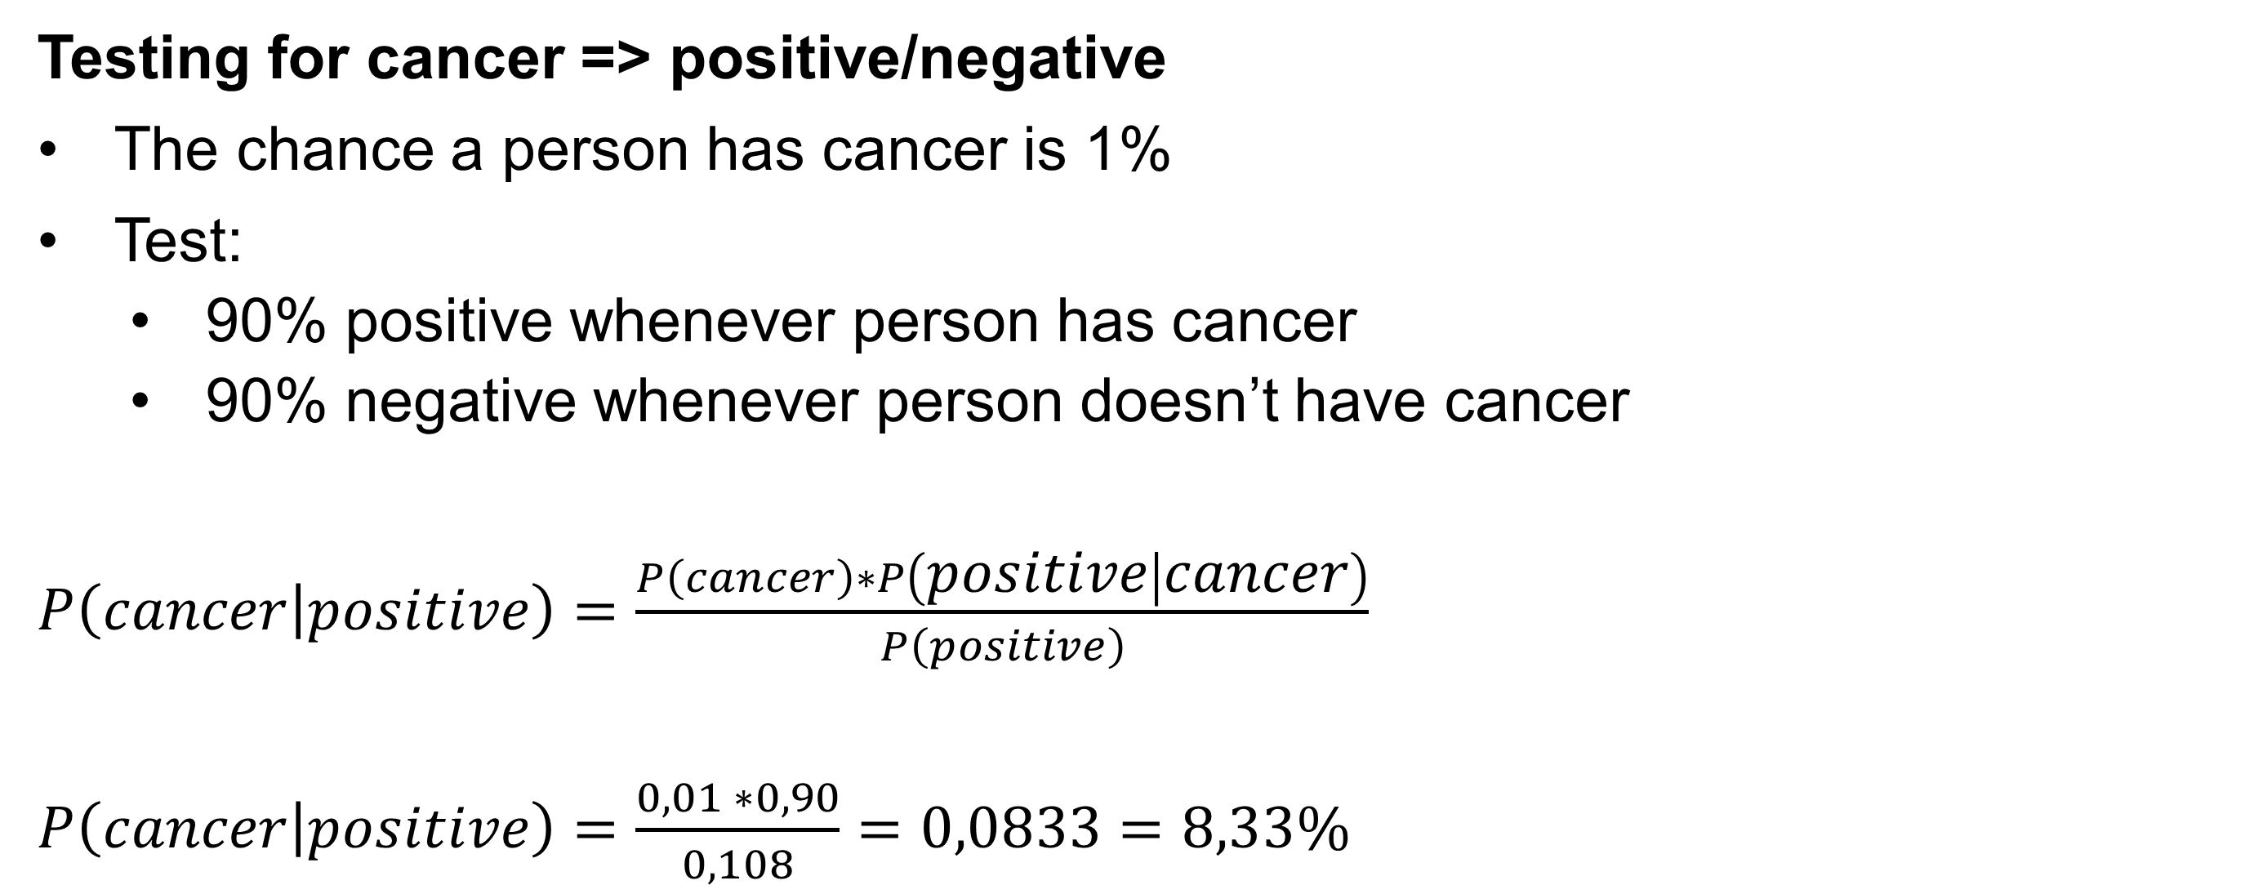
Example of likelihood calculation
Testing for cancer => positive/negative
The chance a person has cancer is 1%
Test:
90% positive whenever person has cancer
90% negative whenever person doesn’t have cancer
$P\left(cancer | positive\right)=\frac{P\left(cancer\right)∗P\left(positive | cancer\right)}{P\left(positive\right)}$
$P\left(cancer | positive\right)=\frac{0,01 ∗0,90}{0,108}=0,0833=8,33\%$

Slide 13
Naïve bayes
Example based on weather dataset
What is the chance we play golf based on certain features?
Features:
Outlook
Temperature
Humidity
Windy
Target:
play
outlook | temperature | humidity | windy | play
overcast | hot | high | FALSE | yes
overcast | cool | normal | TRUE | yes
overcast | mild | high | TRUE | yes
overcast | hot | normal | FALSE | yes
rainy | mild | high | FALSE | yes
rainy | cool | normal | FALSE | yes
rainy | cool | normal | TRUE | no
rainy | mild | normal | FALSE | yes
rainy | mild | high | TRUE | no
sunny | hot | high | FALSE | no
sunny | hot | high | TRUE | no
sunny | mild | high | FALSE | no
sunny | cool | normal | FALSE | yes
sunny | mild | normal | TRUE | yes

Slide 14
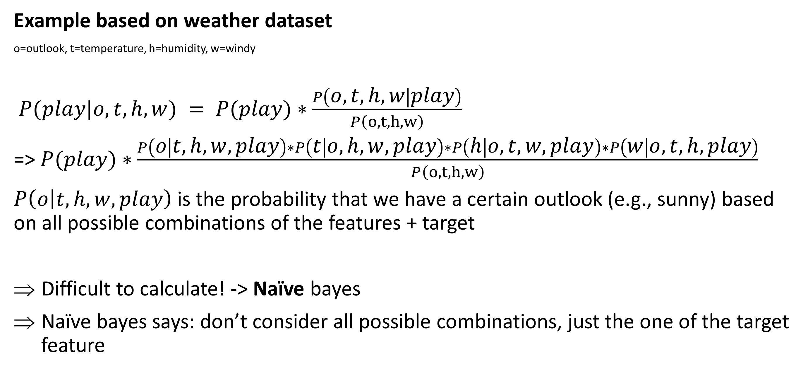
Naïve bayes
Example based on weather dataset
o=outlook, t=temperature, h=humidity, w=windy
$P(play|o,t,h,w) = P(play)∗\frac{P\left(o,t,h,w | play\right)}{P\left(o,t,h,w\right)}$
=> $P(play)∗\frac{P\left(o | t,h,w,play\right)∗P\left(t | o,h,w,play\right)∗P\left(h | o,t,w,play\right)∗P\left(w | o,t,h,play\right)}{P\left(o,t,h,w\right)}$
$P\left(o | t,h,w,play\right)$ is the probability that we have a certain outlook (e.g., sunny) based on all possible combinations of the features + target
Difficult to calculate! -> Naïve bayes
Naïve bayes says: don’t consider all possible combinations, just the one of the target feature

Slide 15
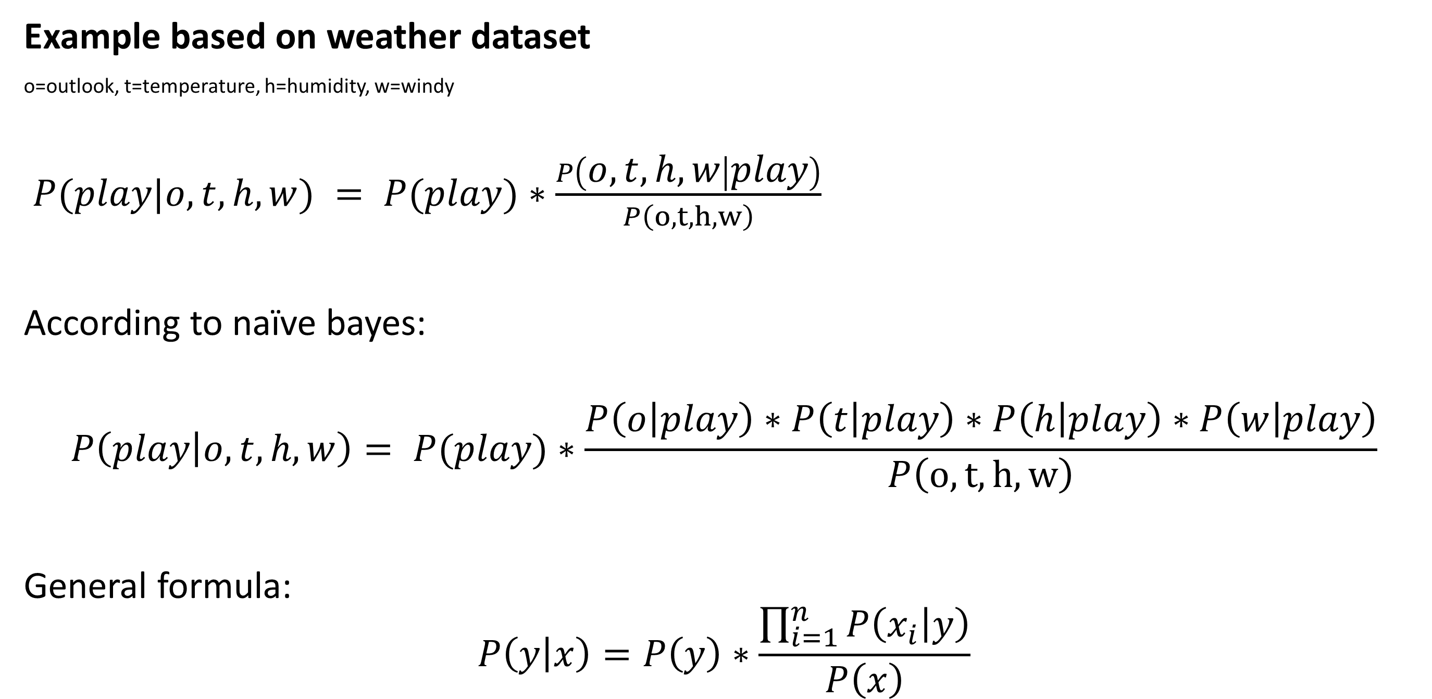
Naïve bayes
Example based on weather dataset
o=outlook, t=temperature, h=humidity, w=windy
$P(play|o,t,h,w) = P(play)∗\frac{P\left(o,t,h,w | play\right)}{P\left(o,t,h,w\right)}$
According to naïve bayes:
$$P\left(play | o,t,h,w\right)= P(play)∗\frac{P\left(o | play\right)∗P\left(t | play\right)∗P\left(h | play\right)∗P\left(w | play\right)}{P\left(o,t,h,w\right)}$$
General formula:
$$P\left(y | x\right)=P\left(y\right)∗\frac{\prod_{i=1}^{n}{P\left(x_{i} | y\right)}}{P\left(x\right)}$$

Slide 16
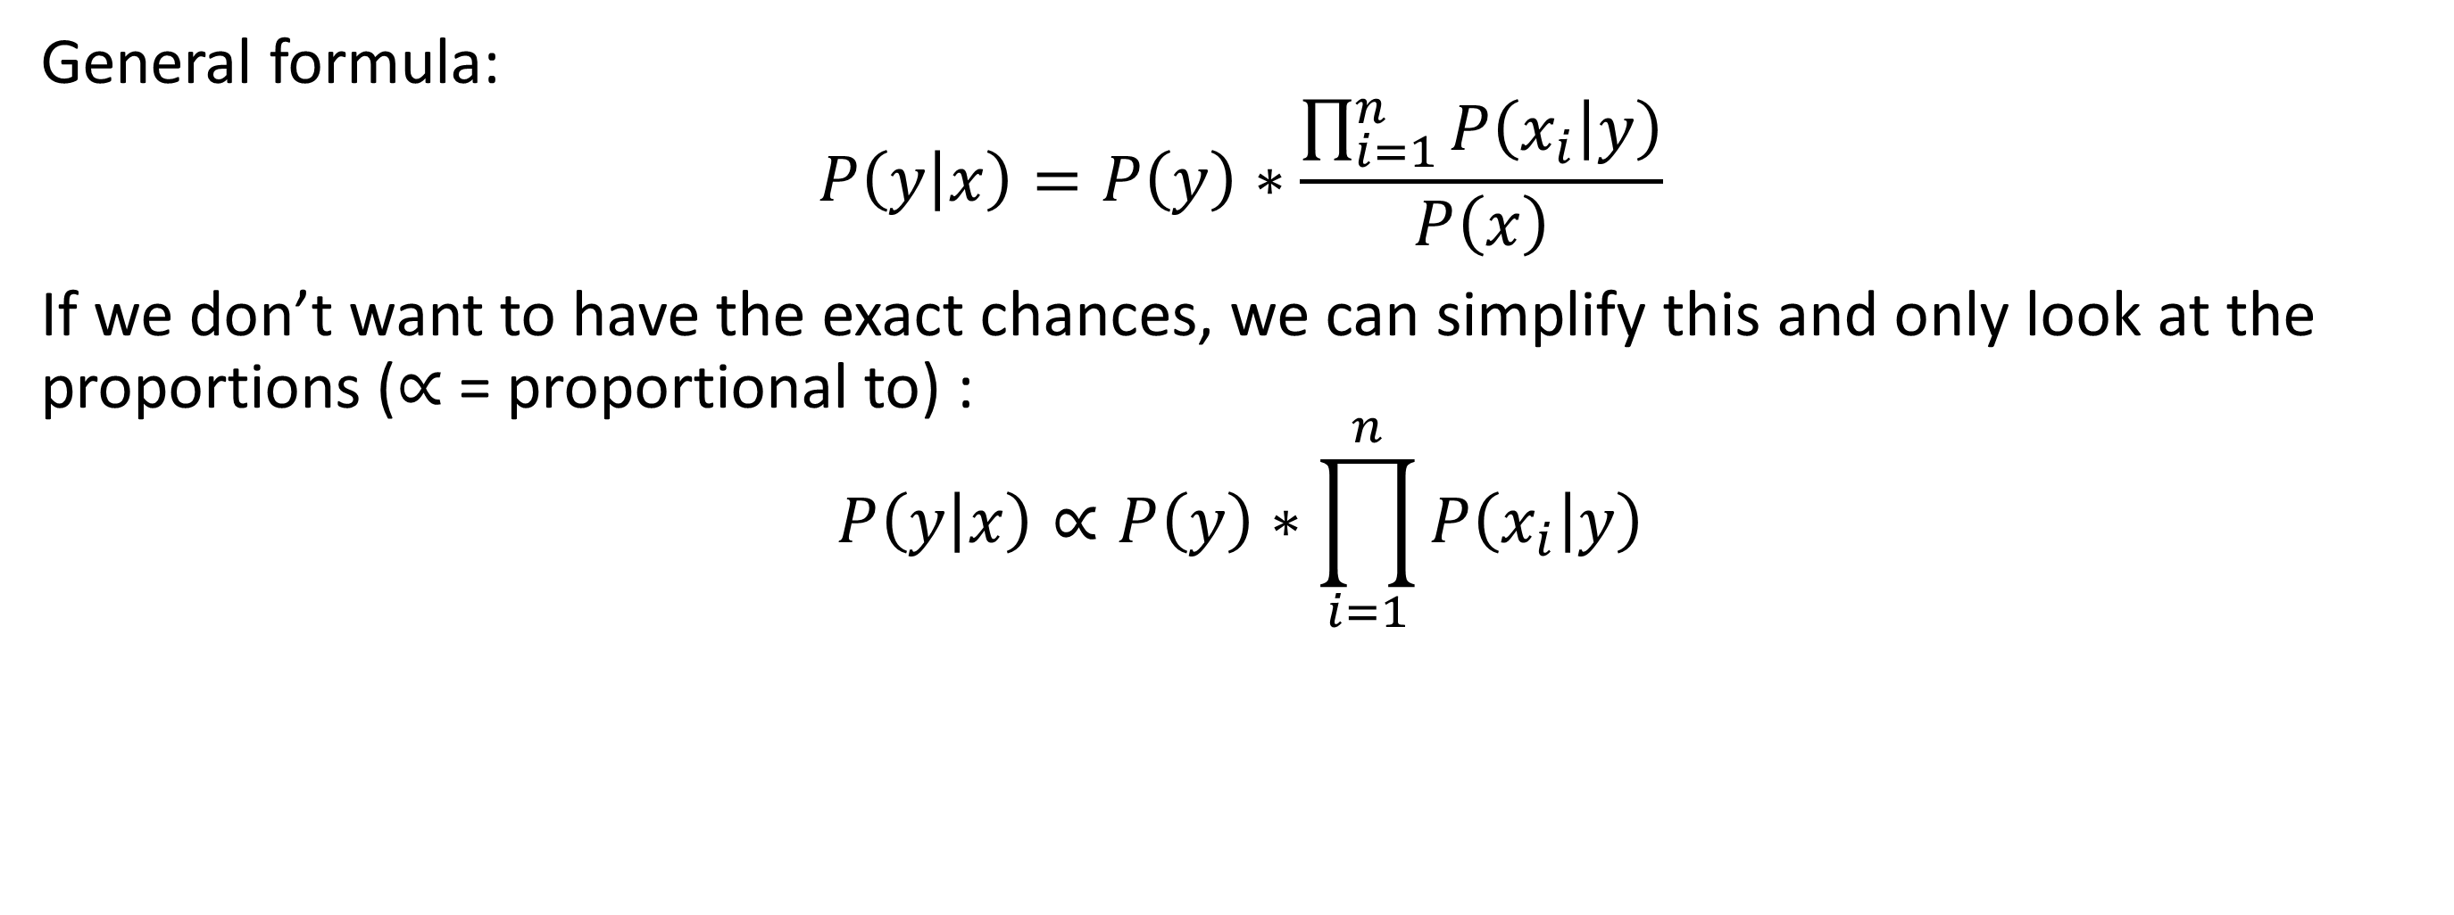
Naïve bayes
General formula:
$$P\left(y | x\right)=P\left(y\right)∗\frac{\prod_{i=1}^{n}{P\left(x_{i} | y\right)}}{P\left(x\right)}$$
If we don’t want to have the exact chances, we can simplify this and only look at the proportions (∝ = proportional to) :
$$P\left(y | x\right)∝P\left(y\right)∗\prod_{i=1}^{n}{P\left(x_{i} | y\right)}$$

Slide 17
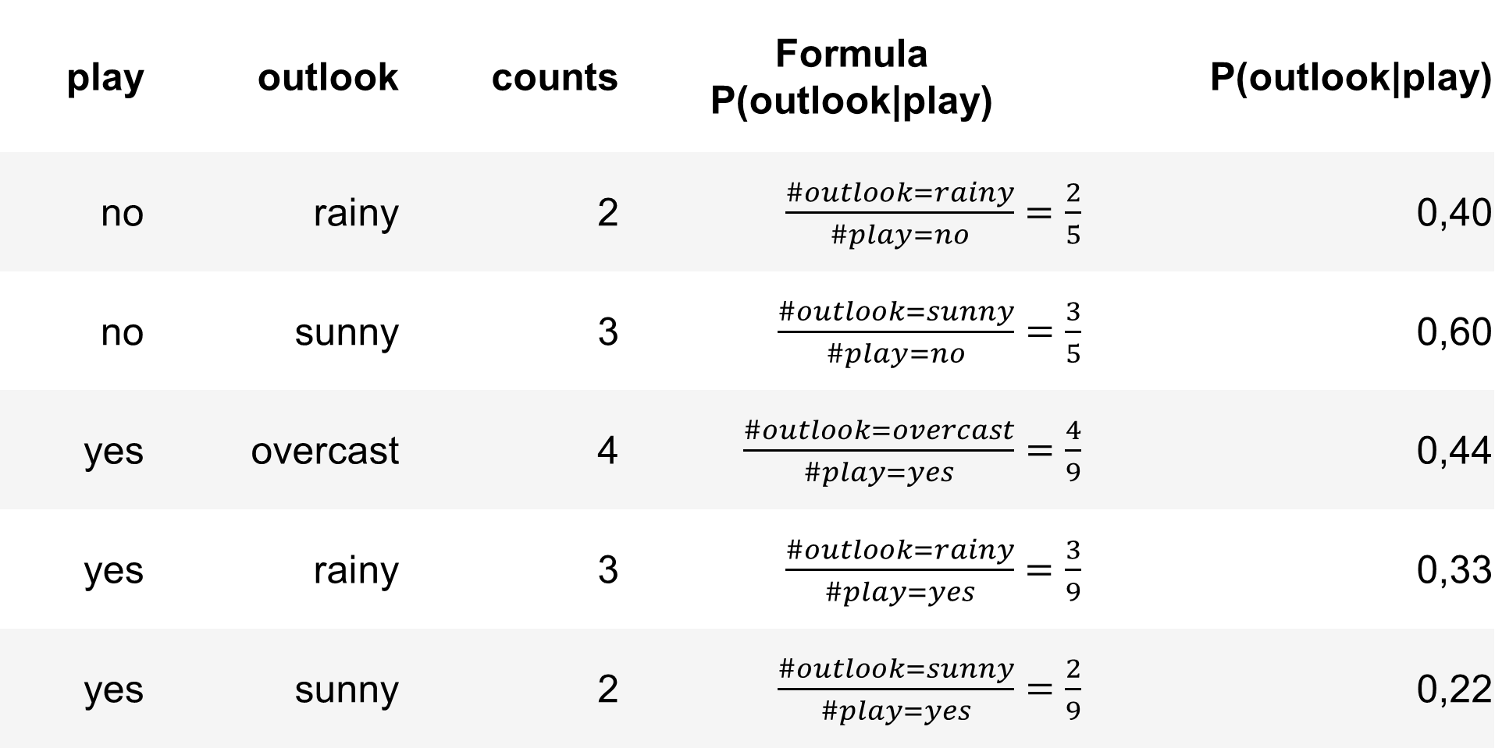
Naïve bayes
Example
Let’s calculate all (naïve) likelihoods for each feature:
P(outlook|play):
outlook | temperature | humidity | windy | play
overcast | hot | high | FALSE | yes
overcast | cool | normal | TRUE | yes
overcast | mild | high | TRUE | yes
overcast | hot | normal | FALSE | yes
rainy | mild | high | FALSE | yes
rainy | cool | normal | FALSE | yes
rainy | cool | normal | TRUE | no
rainy | mild | normal | FALSE | yes
rainy | mild | high | TRUE | no
sunny | hot | high | FALSE | no
sunny | hot | high | TRUE | no
sunny | mild | high | FALSE | no
sunny | cool | normal | FALSE | yes
sunny | mild | normal | TRUE | yes
play | outlook | counts | Formula P(outlook|play) | P(outlook|play)
no | rainy | 2 | $\frac{\#outlook=rainy}{\#play=no}=\frac{2}{5}$ | 0,40
no | sunny | 3 | $\frac{\#outlook=sunny}{\#play=no}=\frac{3}{5}$ | 0,60
yes | overcast | 4 | $\frac{\#outlook=overcast}{\#play=yes}=\frac{4}{9}$ | 0,44
yes | rainy | 3 | $\frac{\#outlook=rainy}{\#play=yes}=\frac{3}{9}$ | 0,33
yes | sunny | 2 | $\frac{\#outlook=sunny}{\#play=yes}=\frac{2}{9}$ | 0,22

Slide 18
Naïve bayes
Example
Let’s calculate all (naïve) likelihoods for each feature:
P(temperature|play):
P(humidity|play):
P(windy|play):
play | temperature | counts | P(temperature|play)
no | cool | 1 | 0,20
no | hot | 2 | 0,40
no | mild | 2 | 0,40
yes | cool | 3 | 0,33
yes | hot | 2 | 0,22
yes | mild | 4 | 0,44
play | humidity | counts | P(humidity|play)
no | high | 4 | 0,80
no | normal | 1 | 0,20
yes | high | 3 | 0,33
yes | normal | 6 | 0,67
play | windy | counts | P(windy|play)
no | FALSE | 2 | 0,40
no | TRUE | 3 | 0,60
yes | FALSE | 6 | 0,67
yes | TRUE | 3 | 0,33

Slide 19
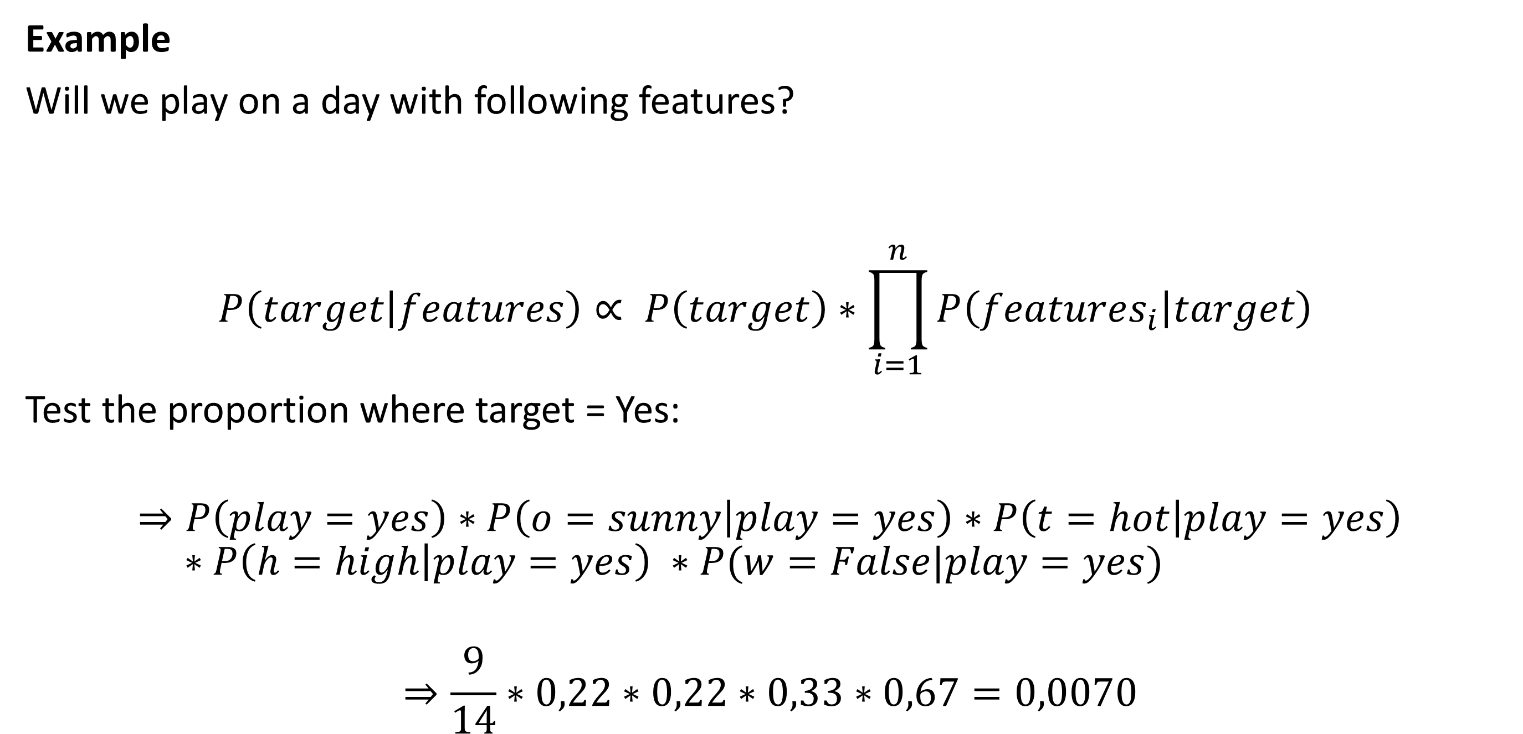
Naïve bayes
Example
Will we play on a day with following features?
$$P\left(target | features\right)∝ P\left(target\right)∗\prod_{i=1}^{n}{P\left(features_{i} | target\right)}$$
Test the proportion where target = Yes:
$$⇒P\left(play=yes\right)∗P\left(o=sunny | play=yes\right)∗P\left(t=hot | play=yes\right) \\ ∗P\left(h=high | play=yes\right) ∗P(w=False|play=yes)$$
$$⇒\frac{9}{14}∗0,22∗0,22∗0,33∗0,67=0,0070$$
outlook | temperature | humidity | windy
sunny | hot | high | False

Slide 20
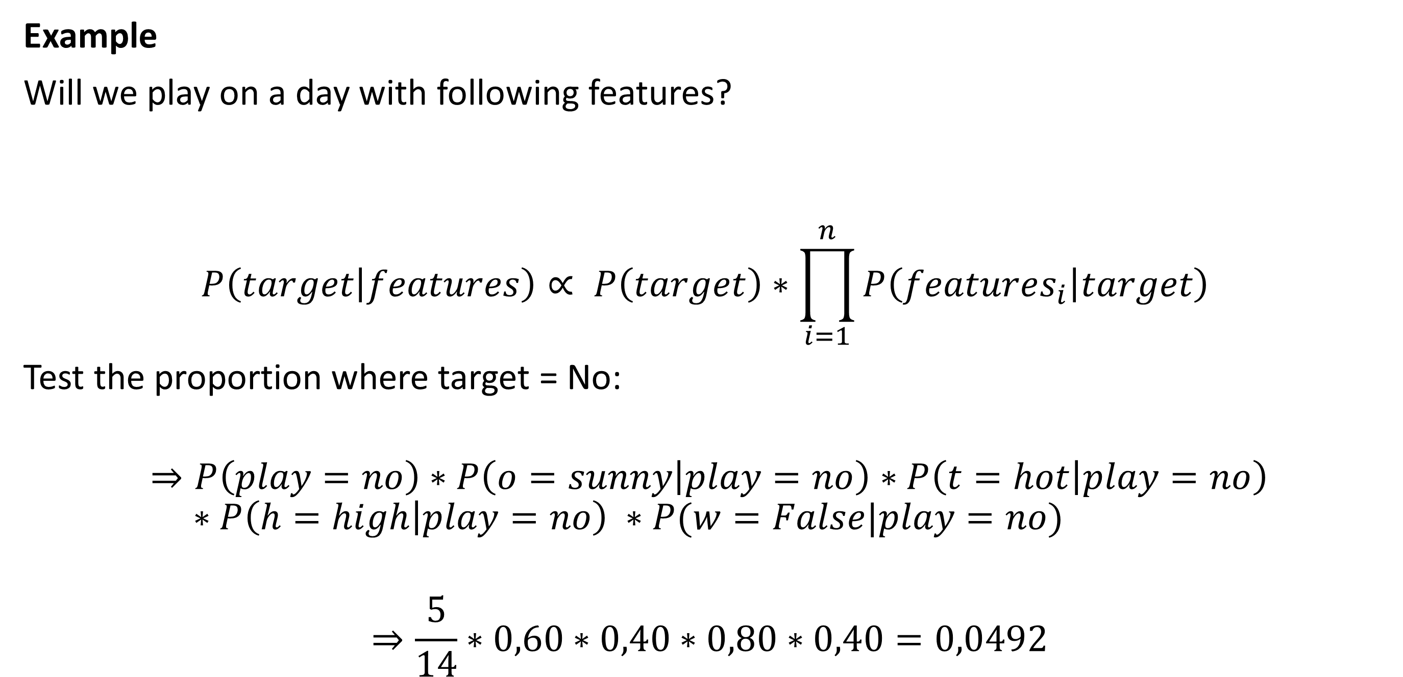
Naïve bayes
Example
Will we play on a day with following features?
$$P\left(target | features\right)∝ P\left(target\right)∗\prod_{i=1}^{n}{P\left(features_{i} | target\right)}$$
Test the proportion where target = No:
$$⇒P\left(play=no\right)∗P\left(o=sunny | play=no\right)∗P\left(t=hot | play=no\right) \\ ∗P\left(h=high | play=no\right) ∗P(w=False|play=no)$$
$$⇒\frac{5}{14}∗0,60∗0,40∗0,80∗0,40=0,0492$$
outlook | temperature | humidity | windy
sunny | hot | high | False

Slide 21
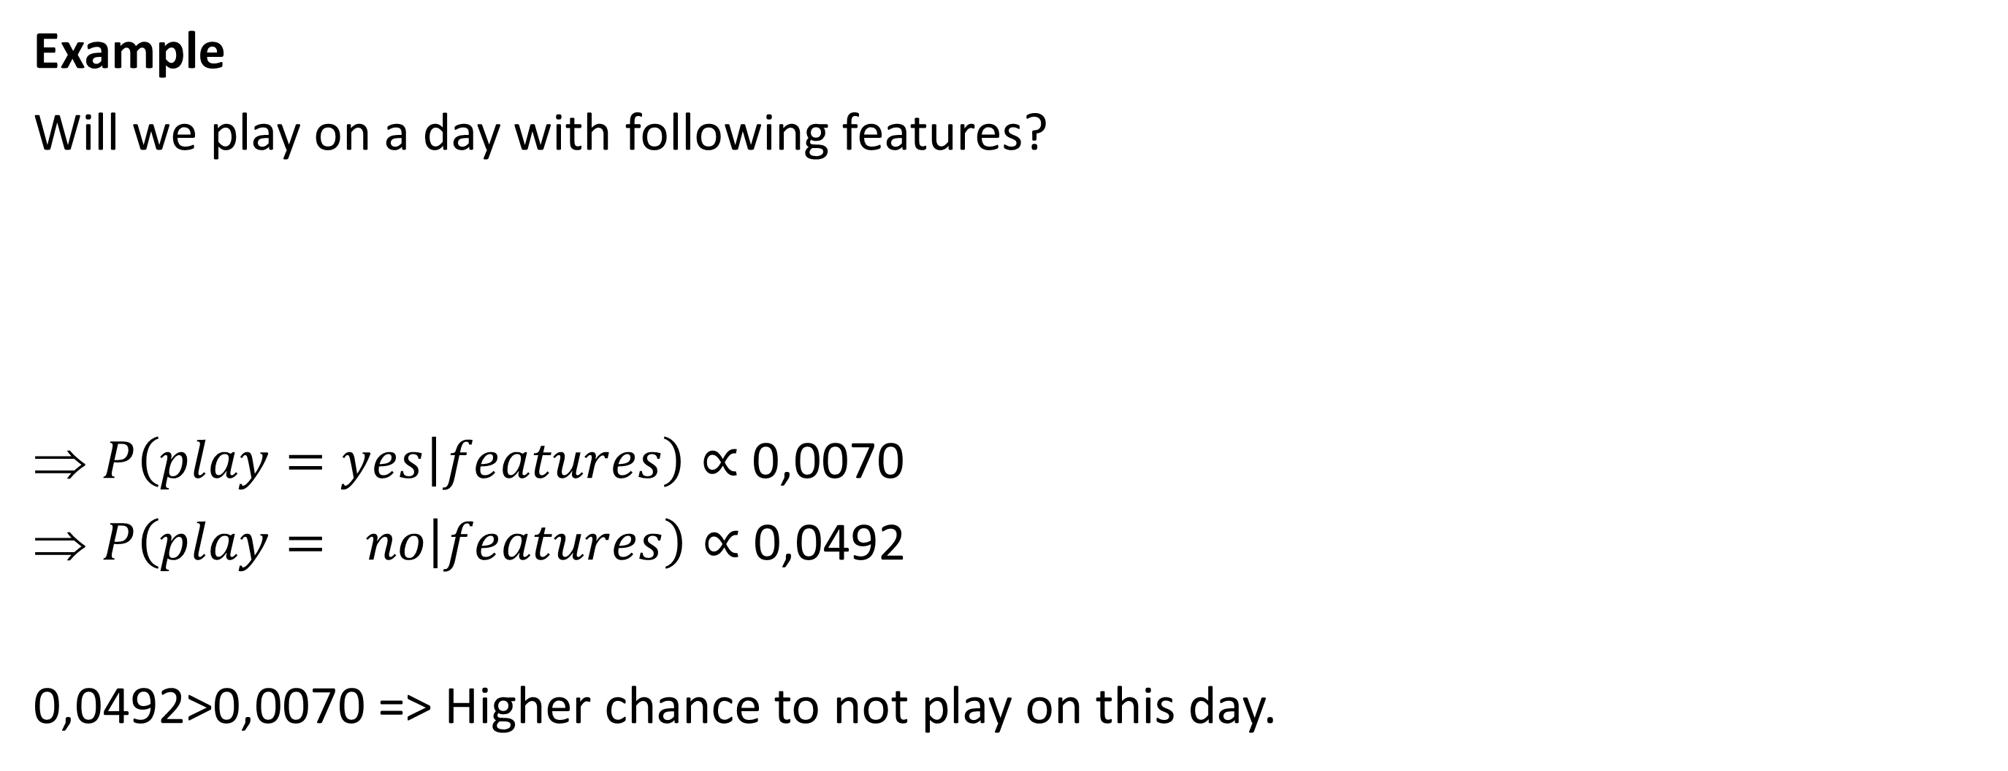
Naïve bayes
Example
Will we play on a day with following features?
$P\left(play=yes | features\right)∝$0,0070
$P\left(play= no | features\right)∝$ 0,0492
0,0492>0,0070 => Higher chance to not play on this day.
outlook | temperature | humidity | windy
sunny | hot | high | False

Slide 22
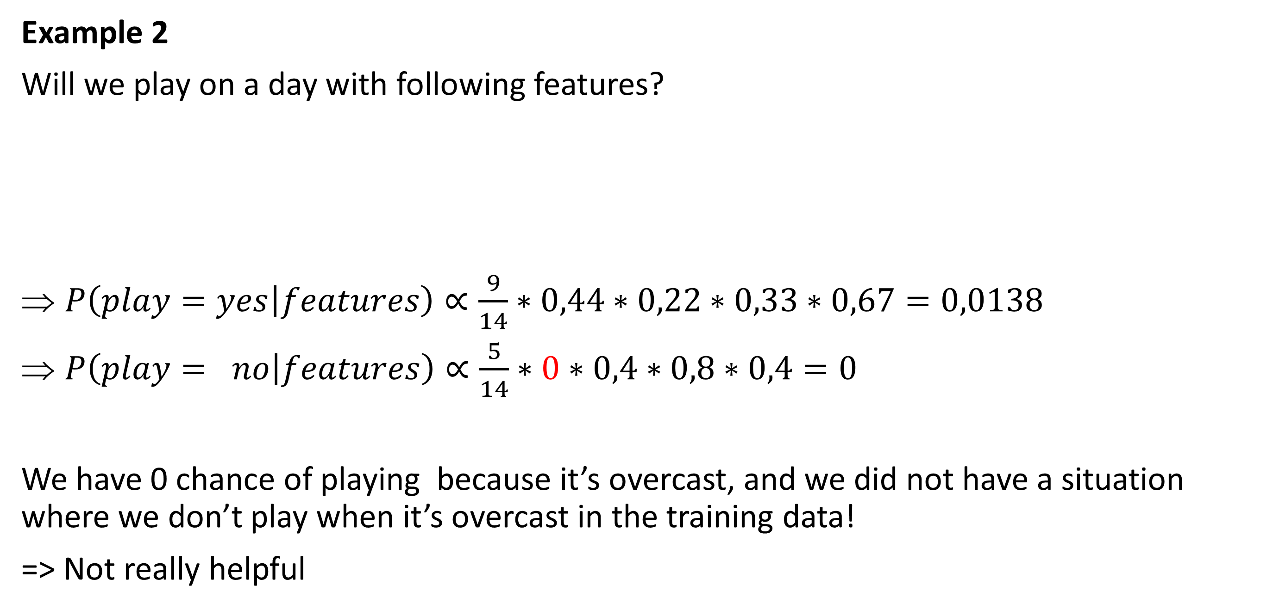
Naïve bayes
Example 2
Will we play on a day with following features?
$P\left(play=yes | features\right)∝\frac{9}{14}∗0,44∗0,22∗0,33∗0,67=0,0138$
$P\left(play= no | features\right)∝\frac{5}{14}∗0∗0,4∗0,8∗0,4=0$
We have 0 chance of playing because it’s overcast, and we did not have a situation where we don’t play when it’s overcast in the training data!
=> Not really helpful
outlook | temperature | humidity | windy
overcast | hot | high | False

Slide 23
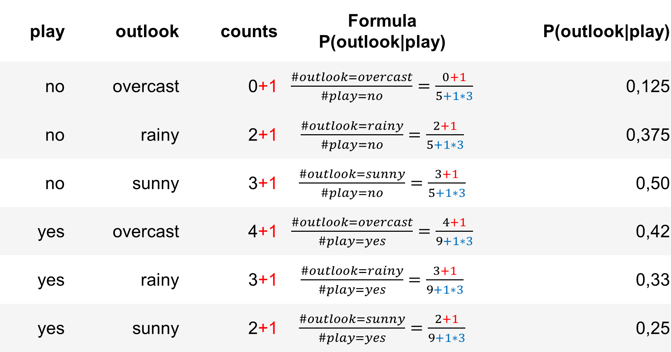
Naïve bayes
Laplacian smoothing
To prevent having 0 chance values. We can, instead of saying 0, always add a small chance to possibly unseen values like P(outlook=‘overcast’,play=no).
We do this by adding 1 to each occurrence in our tables we made before:
play | outlook | counts | Formula P(outlook|play) | P(outlook|play)
no | overcast | 0+1 | $\frac{\#outlook=overcast}{\#play=no}=\frac{0+1}{5+1∗3}$ | 0,125
no | rainy | 2+1 | $\frac{\#outlook=rainy}{\#play=no}=\frac{2+1}{5+1∗3}$ | 0,375
no | sunny | 3+1 | $\frac{\#outlook=sunny}{\#play=no}=\frac{3+1}{5+1∗3}$ | 0,50
yes | overcast | 4+1 | $\frac{\#outlook=overcast}{\#play=yes}=\frac{4+1}{9+1∗3}$ | 0,42
yes | rainy | 3+1 | $\frac{\#outlook=rainy}{\#play=yes}=\frac{3+1}{9+1∗3}$ | 0,33
yes | sunny | 2+1 | $\frac{\#outlook=sunny}{\#play=yes}=\frac{2+1}{9+1∗3}$ | 0,25

Slide 24
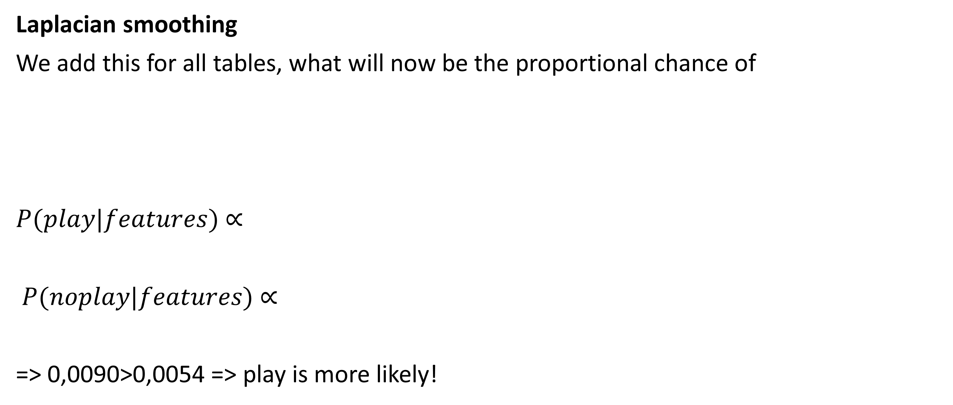
Naïve bayes
Laplacian smoothing
We add this for all tables, what will now be the proportional chance of
$P(play|features)$ ∝
$P(noplay|features)$ ∝
=> 0,0090>0,0054 => play is more likely!
outlook | temperature | humidity | windy
overcast | hot | high | False

Slide 25
Naïve bayes
Laplacian smoothing
Laplacian smoothing is also called the add-one smoothing, since we always add one to the values.
In sklearn, this will be the hyperparameter alpha. An alpha of 1 is the same as illustrated before.

Slide 26
Naïve bayes
Log usage
The values 0,0090 and 0,0054 are already quite small, and this is with a small dataset.
Naïve bayes is often used in sparse datasets!
Imagine having a value only occurring once within hundreds of 1000s of possibilities!
X=y*1/100000*z = 0,0000….
Risk of underflow (computer just converts it to 0)
Use log function to prevent this underflow

Slide 27
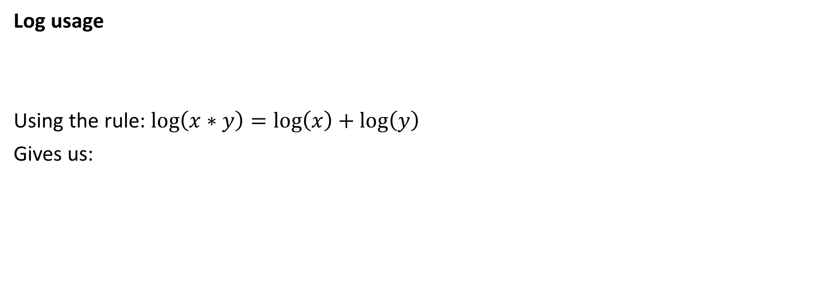
Naïve bayes
Log usage
Using the rule: $\log\left(x∗y\right)=\log\left(x\right)+\log\left(y\right)$
Gives us:

Slide 28
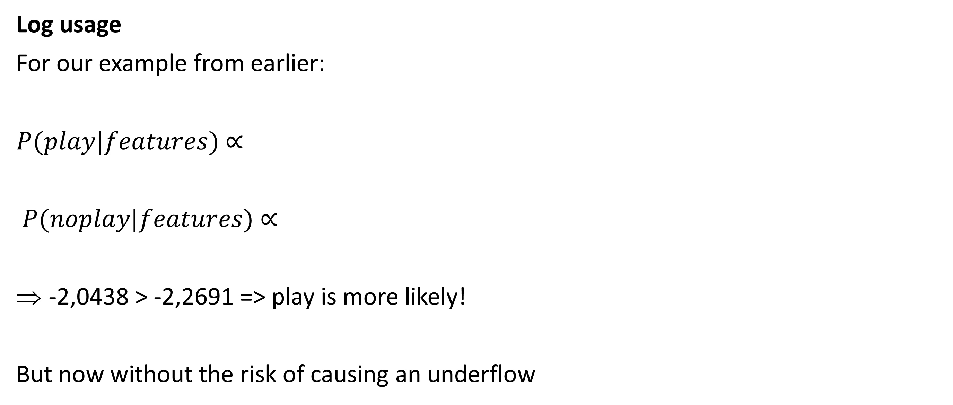
Naïve bayes
Log usage
For our example from earlier:
$P(play|features)$ ∝
$P(noplay|features)$ ∝
-2,0438 > -2,2691 => play is more likely!
But now without the risk of causing an underflow

Slide 29
Naïve bayes - sklearn
model = MultinomialNB(alpha=1)
model.fit(X_train,y_train)
print("Test score:",model.score(X_test,y_test))
Note: using the probabilities function of sklearn ‘model.proba()’, we will get the actual probabilities!
The log probability ‘model.predict_log_proba()’ is the log10 value of these probabilities
Probability without log function: [[0.73618111 0.26381889]] Probability with log function: [[-0.30627912 -1.33249242]]

Slide 30
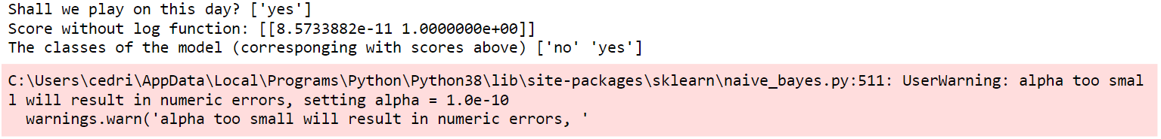
Naïve bayes - sklearn
Alpha of 0 is not allowed in sklearn
Automatically sets it to 1.0e-10
Note that Naïve bayes can also be used on numeric values, not only categorical.

